Slide 1
Content
SAP Overview
ABAP Dictionary/ Data Dictionary
ABAP Basics
Reports
Module Pool Programming
Layout Sets
Data Conversions
Modification and Enhancements
Connectivity
Notes:
First Slide

Slide 2
Content
Overview of BDC
File Handling
File from Presentation Server
File from Application Server
Direct Upload
Using Screen Recording
Call Transaction Method
Session Method
Using Function Modules or BAPIs
Notes:
First Slide

Slide 3
Batch Data Communication/ Conversion
Overview
BDCs are used It is used to transfer Non SAP data to SAP R/3 system
Users will create business documents using transactions manually
Ex:
Purchase orders – ME21/ME21N
Sales orders - VA01
Invoices – VF01 etc.
But we have following situation where creating business documents manually is a tedious
And time consuming task.
Migrating data from Non SAP system to SAP System when implementing SAP
If some business still using Non SAP system and data in the Non SAP system needs to be created to the SAP system .
In this case bulk amount of data needs to be created or
Very frequently it has to be occurred
Very rarely it has to be occurred
We need a automated program which should create business Documents automatically With out human intervention called BDCs also called
Conversion Programs or
Interface Programs
BDC
Overview
File Handling
Direct Upload
Using Screen Recording
Using Function Modules/BAPIS
Notes:
First Slide

Slide 4
Batch Data Communication/ Conversion
Overview
Some of Transactions used
SE38 – Write BDC Programs
SHDB - Screen Recording
SM35 – Process Sessions
SM37 – Job Overview
SE37 – Function Modules
AL11 - Directory listings in application server
Function Modules Used
F4_FILENAME – Get Path of the file in the presentation server
GUI_UPLOAD/ GUI_DOWNLOAD – Upload/download file from/to PS
TEXT_CONVERT_XLS_TO_SAP - Upload Excel file from presentation server
OCS_GET_FILE_INFO - Check existence of the file in the application server
F4_DXFILENAME_TOPRECURSION - Get Path of the file in the application server
EPS_GET_DIRECTORY_LISTING - Directory listing in the application server
Commands:
OPEN DATASET
TRANSFER
CLOSE DATASET
Layout sets
Overview
SAP Scripts
Driver Program
Smartforms
NACE Configuration
Print Parameters
Notes:
First Slide

Slide 5
Batch Data Communication/ Conversion
Overview
BDC
BDC Program
Get/Fetch Non SAP Data
Validate and Convert the Data
Process the Data
Call the Application program to post the Data
Handle the messages and Display
Application Program
It can be Transaction such as ME21, VA01 etc
It can be a Function module or BAPI such as BAPI_PO_CREATE etc
Overview
Data Source
Flat Files
Data Sets
Z-Tables
IDocs etc
File Handling
Direct Upload
Using Screen Recording
Using Function Modules/BAPIS
SAP Database
Notes:
First Slide

Slide 6
Batch Data Communication/ Conversion
Overview
File Handling:
It is a procedure to upload/ download to/from
Presentation Server
Application Server
Data can be in the following format in the Presentation server
Text file
Space separated records
Comma separated records
Any Delimiter separated records
Tab space separated records
Excel File
BDC
Overview
File Handling
Direct Upload
Using Screen Recording
Using Function Modules/BAPIS
Notes:
First Slide

Slide 7
Batch Data Communication/ Conversion
Overview
Handling Files in the Presentation server
Upload
Choose file and its path
Upload file from Presentation Server to internal table
Download
Choose file and its path
Download file to Presentation server from internal table
Get Path of the file in the presentation server
F4_FILENAME
CL_GUI_FRONTEND_SERVICES=>FILE_OPEN_DIALOG
Upload
GUI_UPLOAD
TEXT_CONVERT_XLS_TO_SAP
CL_GUI_FRONTEND_SERVICES=>GUI_UPLOAD
Download
GUI_DOWNLOAD
CL_GUI_FRONTEND_SERVICES=>GUI_DOWNLOAD
BDC
Overview
File Handling
Direct Upload
Using Screen Recording
Using Function Modules/BAPIS
Notes:
First Slide

Slide 8
Batch Data Communication/ Conversion
Overview
Handling Files in the Application Server
Dataset: File in the Application server is called Dataset
Upload from Application Server
Choose Directory
Open Dataset
Read Content
Close Dataset
Download to Application Server
Choose Directory
Open Dataset
Transfer Data
Close Dataset
Get Path of the file in the presentation server
F4_DXFILENAME_TOPRECURSION
BDC
Overview
File Handling
Direct Upload
Using Screen Recording
Using Function Modules/BAPIS
Notes:
First Slide

Slide 9
Batch Data Communication/ Conversion
Overview
Open Dataset
OPEN DATASET <dataset Name> FOR <Input/Output>
IN <text Mode/Binary Mode> ENCODING <encoding>
Transfer data to Application server:
TRANSFER <dobj>TO <dataset> [LENGTH len]
Read data from Application server:
READ DATASET <dataset name >INTO <dobj>
Close Dataset
CLOSE DATASET <dataset name>
BDC
Overview
File Handling
Direct Upload
Using Screen Recording
Using Function Modules/BAPIS
Notes:
First Slide

Slide 10
Batch Data Communication/ Conversion
Overview
Before Proceeding further Just look at Function process of typical Manufacturing industry to understand better
BDC
BANK
Overview
File Handling
ORGANIZATION
VENDORS
Direct Upload
Finance Dept
CUSTOMERS
Using Screen Recording
Purchasing dept.
Sales Dept.
Using Function Modules/BAPIS
Inventory Dept.
Production Dept
MANUFACTURING UNIT
Notes:
First Slide

Slide 11
Batch Data Communication/ Conversion
Overview
Various departments in the organization and each department has its own set of activities
Ex:
Purchasing Dept. is responsible for
identifying the requirements in the organization
Identify vendors
Choose Vendors
Start Procurement
Track Purchase Order
Receive Goods from Vendors
Post to the Inventory
Update details to the Finance department for payments processing
Sales Department is Responsible for
Receive orders from customer
Check inventory
If stock is available then start the delivery
If stock is not available then reach out Procurement dept. or Production department
The contact third party shipping organization for transportation
Confirm the shipment
Generate bills
Update details to the finance department for payment processing
BDC
Overview
File Handling
Direct Upload
Using Screen Recording
Using Function Modules/BAPIS
Notes:
First Slide

Slide 12
Batch Data Communication/ Conversion
Overview
How SAP is supporting this activities.?
A Single solution for various activities in the business is SAP ECC an ERP Product
SAP ECC contains several applications which will help business users to record each and every activity
SAP ECC contains several modules and each modules contains several applications
Core Modules include
MM – Material Management
SD - Sales & Distribution
PP - Production Planning and Control
FI - Finance
CO - Controlling
BDC
Overview
File Handling
Direct Upload
Using Screen Recording
Using Function Modules/BAPIS
Notes:
First Slide

Slide 13
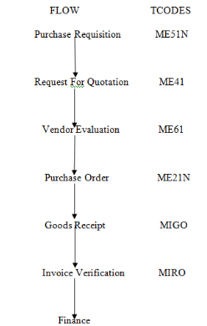
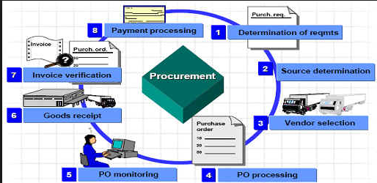
Batch Data Communication/ Conversion
Overview
Lets have look at Material Management
BDC
Overview
File Handling
Direct Upload
Using Screen Recording
Using Function Modules/BAPIS
Notes:
First Slide

Slide 14
Batch Data Communication/ Conversion
Overview
Direct Upload/Update
In this method, we will directly modify the content in the table using OPEN SQL statements such as INSERT, MODIFY, UPDATE & DELETE
Advantages:
As we are directly working at database level, it will be the more faster
Disadvantages:
No validation will take place . Hence there is a chance that incorrect/invalid data will be updated
For example: if no transaction/program is exists for the tables updation i.e. generally for Z-tables which will store data which is coming from third party systems or other SAP systems
Data which does not required any validations
So This method will be used only in few business scenarios
BDC
Overview
File Handling
Direct Upload
Using Screen Recording
Using Function Modules/BAPIS
Notes:
First Slide

Slide 15
Batch Data Communication/ Conversion
Overview
Using Screen Recording
In this approach we will update the business document/tables using screen recording
Advantages:
All validations will be taken place and errors will be raised if any
Disadvantages
Little bit slow comparing Direct upload/update
There are two method in this approach
Call Transaction Method
Session Method
BDC
Overview
File Handling
Direct Upload
Using Screen Recording
Using Function Modules/BAPIS
Steps for BDC Program:
Upload data to internal tables
Fill BDCDATA structures
Choose any method: Call Transaction or Session Method
Handle Errors
Notes:
First Slide

Slide 16
Batch Data Communication/ Conversion
Overview
BDC
BDC Program
Get/Fetch Non SAP Data
Validate and Convert the Data
Process the Data
Call the Application program/Transaction to post the Data
Handle the messages and Display
Application Program
It can be Transaction such as ME21, VA01 etc
It can be a Function module or BAPI such as BAPI_PO_CREATE etc
Overview
Data Source
Flat Files
Data Sets
Z-Tables
IDocs etc
File Handling
Direct Upload
Using Screen Recording
Using Function Modules/BAPIS
SAP Database
Same Diagram Again …...
Notes:
First Slide

Slide 17



Batch Data Communication/ Conversion
Overview
How to call Transaction from your BDC Program ????
BDC
Overview
File Handling
Direct Upload
CALL TRANSACTION
Using Screen Recording
Using Function Modules/BAPIS
CALL TRANSACTION <Transaction Code>
USING <bdcdata>
UPDATE <update – A or S>
MODE <Mode – A or E or N>
MESSAGES IN <bdcmsgcoll>
Notes:
First Slide

Slide 18

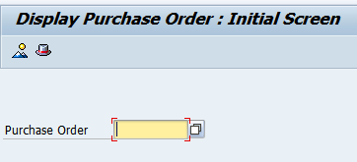
Batch Data Communication/ Conversion
Overview
CALL TRANSACTION statement calls the transaction as below
BDC
Overview
Whenever this report executed, program will call the transaction as below.
File Handling
Direct Upload
Using Screen Recording
Using Function Modules/BAPIS
But at this time we didn’t supply any data from Z-program to ME23 program
We have two ways to supply data
Using Parameter IDs which are available at Data Element Level: this approach will be used when calling transaction for display purpose
Using BDCDATA: this approach will be used when calling transaction for creating or changing the busies document
Notes:
First Slide

Slide 19

Batch Data Communication/ Conversion
Overview
“CALLING TRANSACTION” is OK But how to populate Values on to screen Fields from BDC Program
&
How to link BDC Program and Application Program ???
BDC
Overview
File Handling
Direct Upload
Using Screen Recording
Using Function Modules/BAPIS
Notes:
First Slide

Slide 20

Batch Data Communication/ Conversion
Overview
BDC
Overview
BDC ప్రోగ్రాం కి
అప్లికేషన్ ప్రోగ్రాం కి
అనుసంధానమైనది
BDCDATA
నాయన
File Handling
Direct Upload
Using Screen Recording
Using Function Modules/BAPIS
Notes:
First Slide

Slide 21
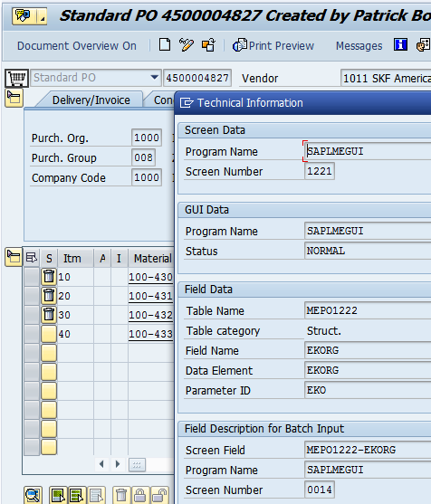
Batch Data Communication/ Conversion
Overview
What is BDCDATA & What is Screen Recording????
&
How you are going populate fields on screen
BDC
Overview
File Handling
Direct Upload
Technical information of the field
Program
Screen Number
Field Name
Value in Field
If we want to populate field in the screen programmatically then we have to fill above details in a structure called
BDCDATA
Using Screen Recording
Using Function Modules/BAPIS
Notes:
First Slide

Slide 22
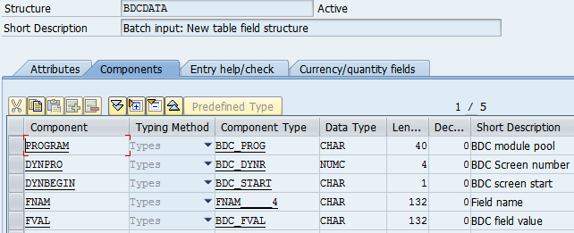
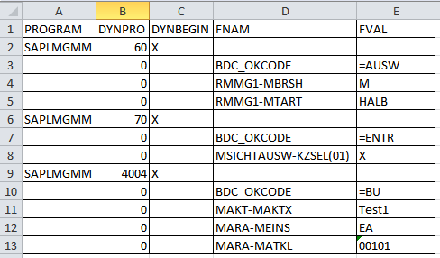
Batch Data Communication/ Conversion
Overview
BDCDATA is a structure and having following fields
BDC
Overview
File Handling
Direct Upload
Using Screen Recording
Using Function Modules/BAPIS
Program & Screen Details
Function Code Details
Field Name and Values
Notes:
First Slide

Slide 23
Batch Data Communication/ Conversion
Overview
BDC
CALL TRANSACTION <Transaction Code>
USING <bdcdata>
UPDATE <update – A or S>
MODE <Mode – A or E or N>
MESSAGES IN <bdcmsgcoll>
Overview
File Handling
Direct Upload
BDCDATA - Screen Values for Application Program screens populated in BDCDATA
UPDATE – Parameter for controlling Application Program and Database interaction
MODE - Application Program Execution Mode
MESSAGES – Messages raised during application program execution will be collected
Using Screen Recording
Using Function Modules/BAPIS
Notes:
First Slide

Slide 24
Batch Data Communication/ Conversion
Overview
Options in CALL TRANSACTION – UPDATE Indicator
Asynchronous-A:
If this indicator set then program will sends series of records to the update work process and will not wait for the acknowledgement (Success Or Failure)
It will keep transmit the records
Synchronous – S:
if this indicator set then program will transfer a record to the update work process and wait for the acknowledgement. Once it gets acknowledgement then it transfers the next record will be sent to the update work process and so on.
By default it is Asynchronous update
Options in CALL TRANSACTION – MODE Indicator
A – Display all screens mode
E – Display only Error Screens
N – Display no Screens
By default it is ‘A’
BDC
Overview
File Handling
Direct Upload
Using Screen Recording
Using Function Modules/BAPIS
Notes:
First Slide

Slide 25
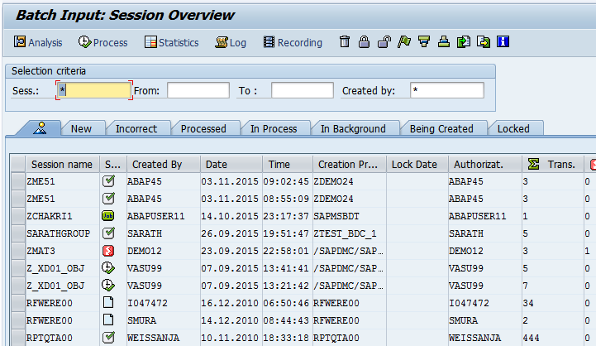
Batch Data Communication/ Conversion
Overview
Session Method
In this technique; data will not be updated into the database immediately when running your BDC program.
Data files(Sessions or Files or Queues) on application server will be created whenever we have executed BDC program. We can process these sessions using transaction SM35
Once we process the sessions then data will be actually updated in the R/3 system database
BDC
Overview
File Handling
Direct Upload
Using Screen Recording
Using Function Modules/BAPIS
Notes:
First Slide

Slide 26
Batch Data Communication/ Conversion
Overview
Function Modules
BDC_OPEN_GROUP
This method is used to create session on application server and maintained in transaction SM35
Parameters:
Group: Name of session
Holddate: Session is locked on the provided date
Keep: (X or Space) Keep or delete after processing completed
User: SAP user id
2. BDC_INSERT
This will insert an internal table of structure of BDCDATA on application server
Parameters:
Tcode: Transaction Name
DynproTab: BDCDATA internal table
BDC_CLOSE_GROUP
This will close the session on application server
Note: We no need to write any logic in the BDC program for handling errors/logs as system will automatically handles it in SM35
BDC
Overview
File Handling
Direct Upload
Using Screen Recording
Using Function Modules/BAPIS
Notes:
First Slide

Slide 27
Batch Data Communication/ Conversion
Overview
SM35: Batch Input Session Overview
Status:
New: Newly Created
Incorrect: Processed but having errors
Processed: Processed Correctly
In Process:` Currently running
In Background: Running in Background
We can execute the session in two ways
1. Direct – F8
2. Background Mode – F5
Log: Click button or on application tool bar
BDC
Overview
File Handling
Direct Upload
Using Screen Recording
Using Function Modules/BAPIS
Notes:
First Slide

Slide 28
Batch Data Communication/ Conversion
Overview
Call Transaction
Data will be transferred directly to the database
Need to handle messages explicitly in BDC program
Call transaction in both Synchronous or Asynchronous : sy-subrc will be returned
Generally for small amount of data
Session Method:
Data will not be transferred to database immediately as sessions are created in Application server
Messages handled by the system in SM35
Only Synchronous process for updating data
SY-SUBRC will not be returned
Generally used for huge amount of data
Advantages of BDC
No Manual intervention
Automatic Data transfer
Data integrity maintained
BDC
Overview
File Handling
Direct Upload
Using Screen Recording
Using Function Modules/BAPIS
Notes:
First Slide

Slide 29
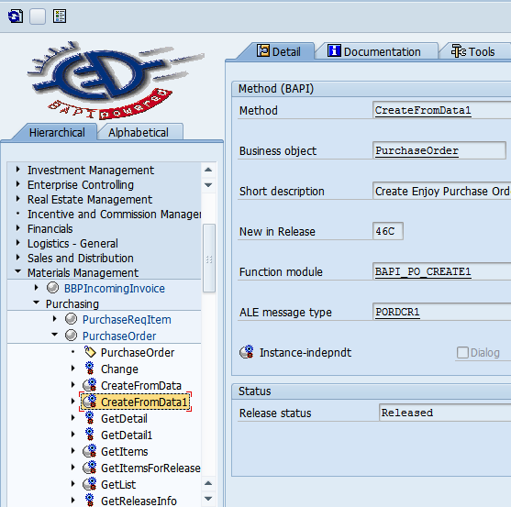
Batch Data Communication/ Conversion
Overview
Create Business document using Function Module or BAPIs
We can use function modules or BAPIs to create Business documents . We can use transaction BAPI to check for Business Objects
BDC
Overview
File Handling
Direct Upload
Using Screen Recording
Using Function Modules/BAPIS
Notes:
First Slide

Slide 30
Batch Data Communication/ Conversion
Overview
BDC
Examples:
Overview
File Handling
Direct Upload
Using Screen Recording
Using Function Modules/BAPIS
Notes:
First Slide

